Slide 1
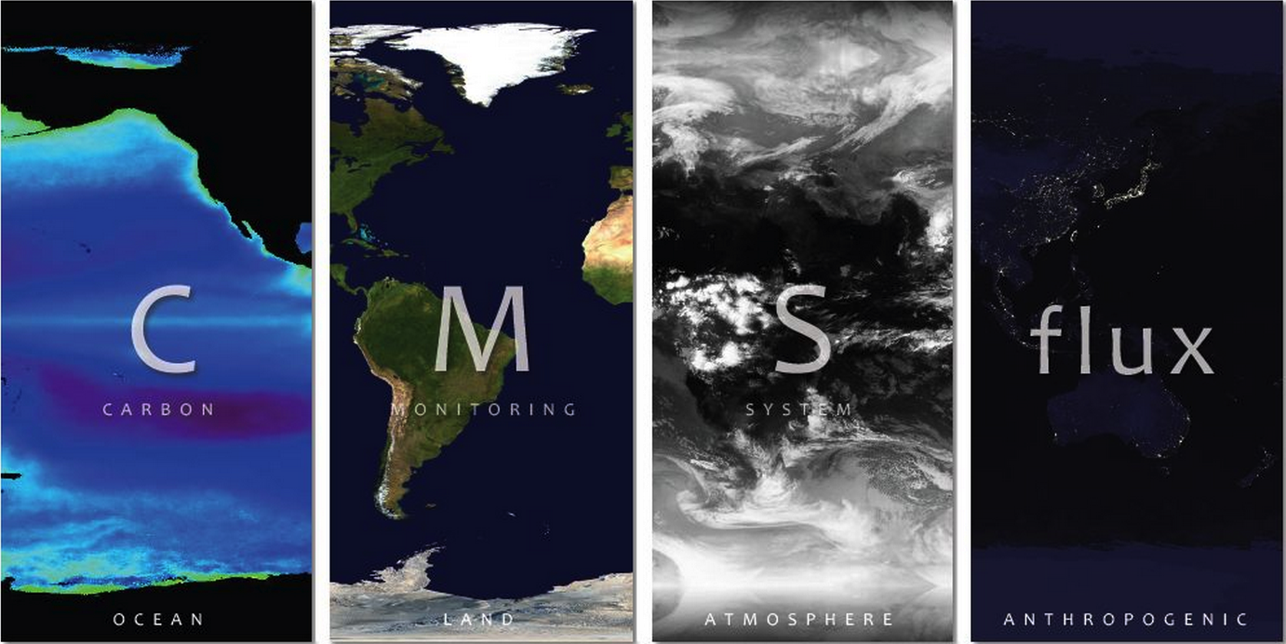

Slide 2
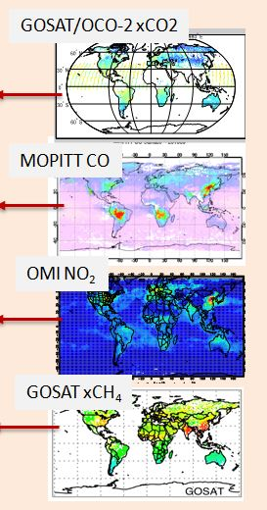
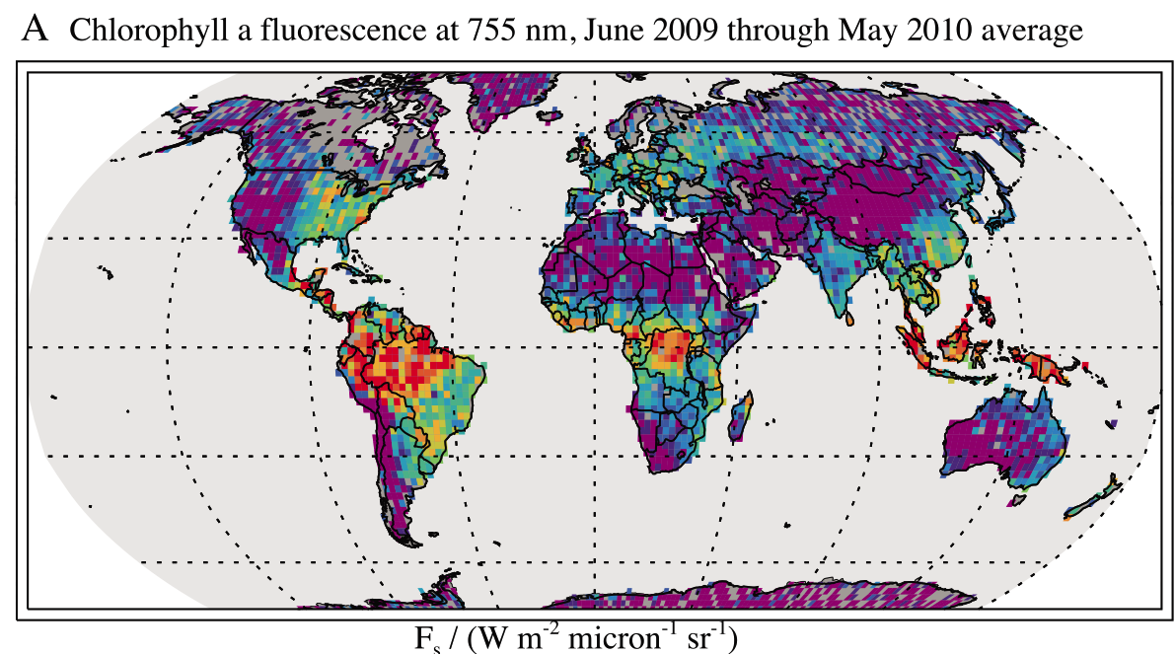
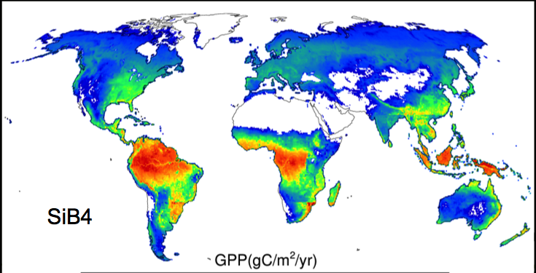
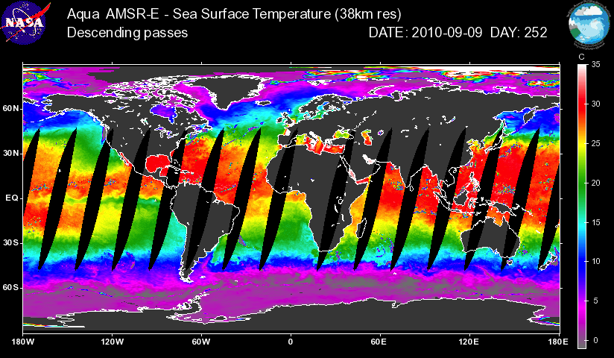
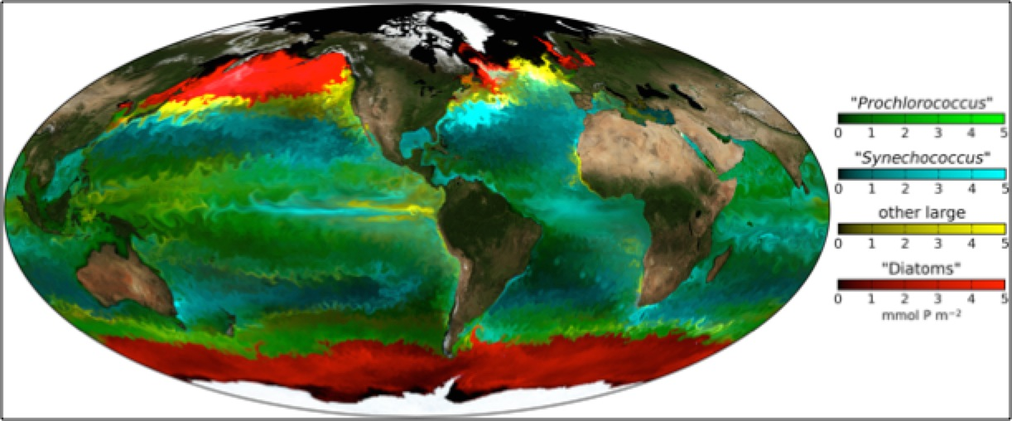
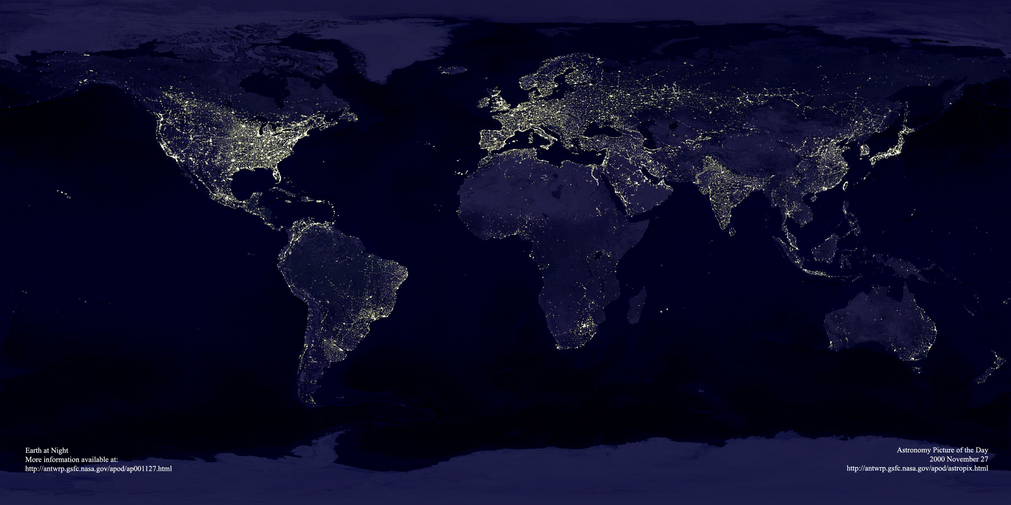
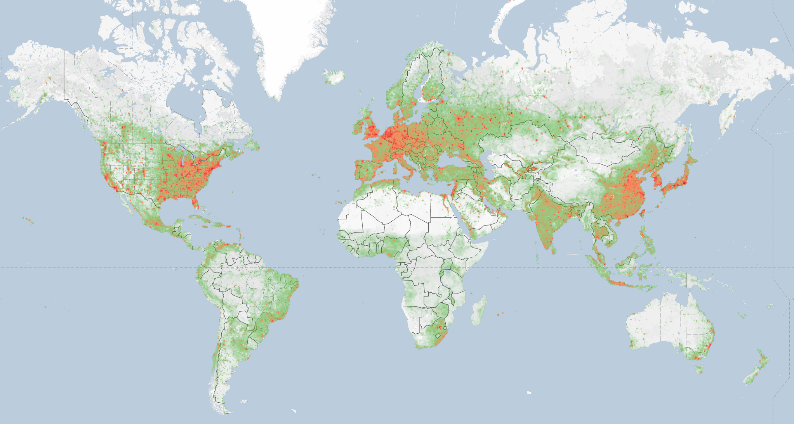
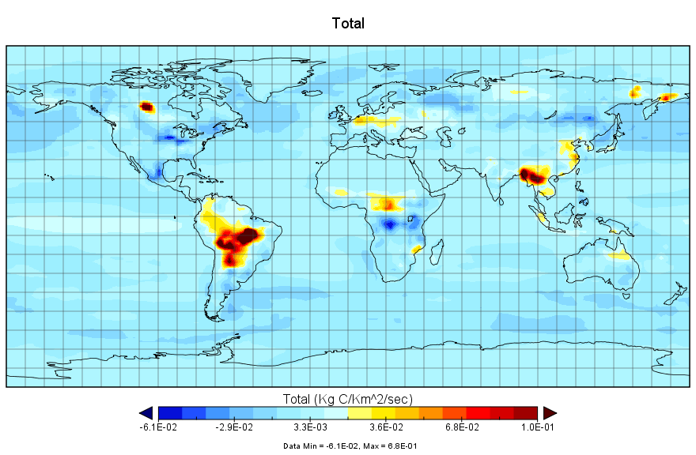
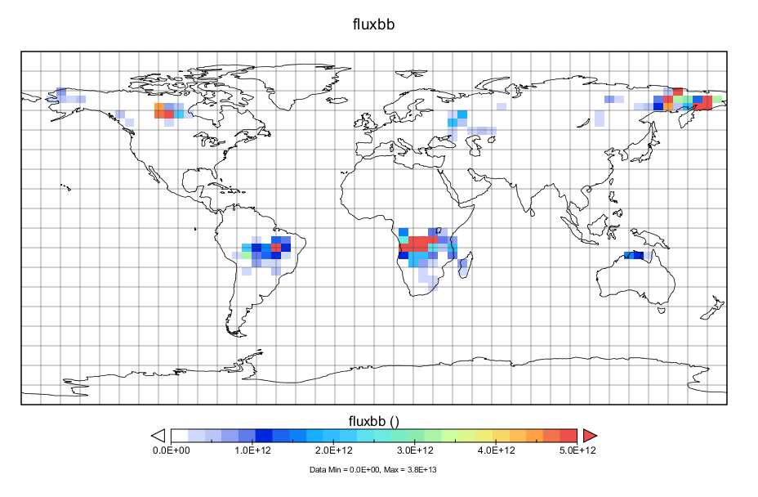
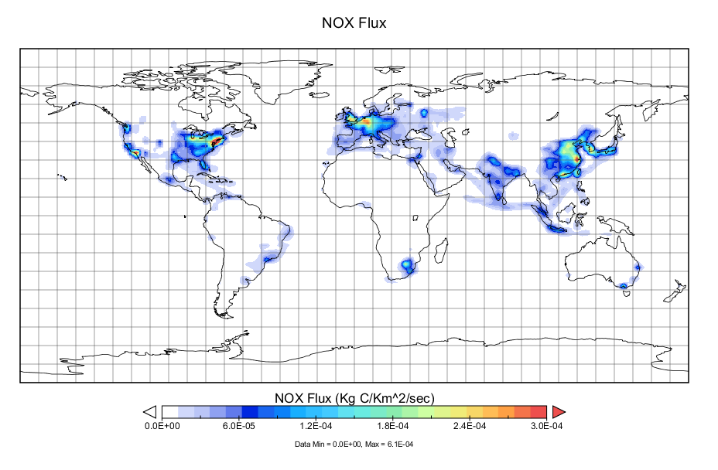
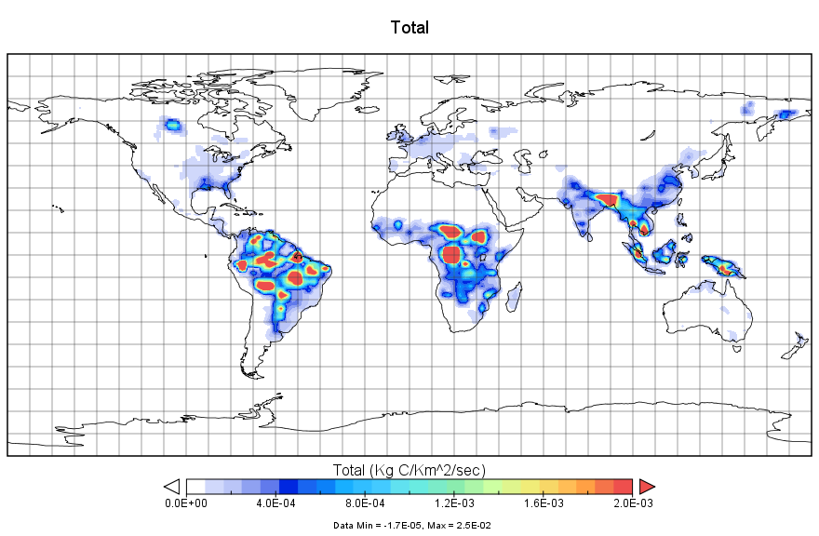
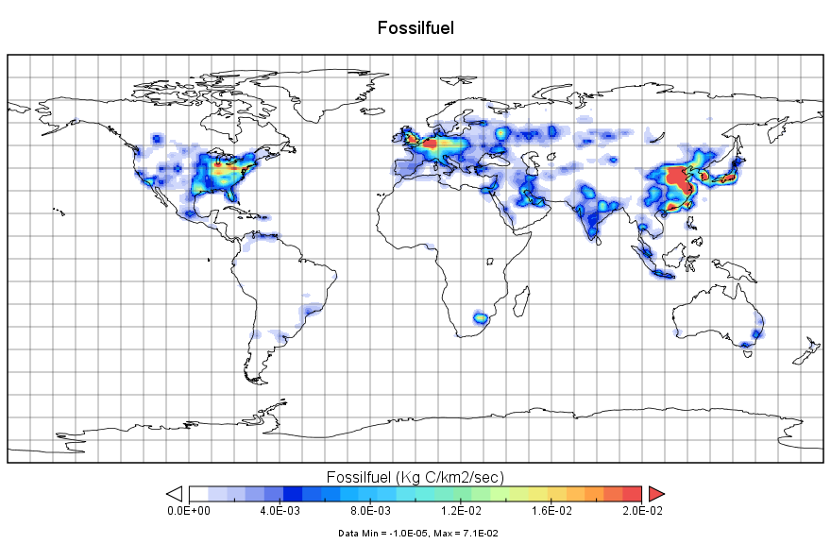
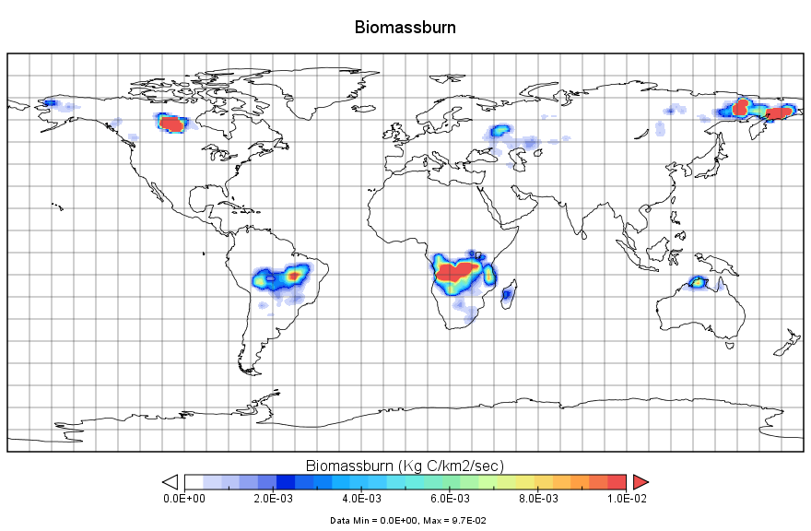
“Bottom-up”
CMS-Flux Framework
“Top-down”
Surface
Satellite Data
Carbon Cycle Models
Chemistry Transport Model
Atmospheric
Satellite Data
Terrestrial
Ocean
Forecast
Surface fluxes and uncertainties
Observations
Human
Inverse modeling
Reconciliation
Top-down estimates
Total CO₂
NO₂
Total CH₄
CO
Fossil Fuel- NO₂:CO₂
Combustion CO:CH4:CO₂
Posterior fluxes and uncertainties
Attribution
Notes:
GEOS-Chem has a rich history of use in understanding atmospheric composition and the inference of surface fluxes.

